Slide 1
Chapter 5 Loops
© Copyright 2012 by Pearson Education, Inc. All Rights Reserved.

Slide 2
Motivations
Suppose that you need to print a string (e.g., "Programming is fun!") a hundred times. It would be tedious to have to write the following statement a hundred times:
print("Programming is fun!");
So, how do you solve this problem?

Slide 3
Opening Problem
Problem:
print("Programming is fun!");
print("Programming is fun!");
print("Programming is fun!");
print("Programming is fun!");
print("Programming is fun!");
print("Programming is fun!");
…
…
…
print("Programming is fun!");
print("Programming is fun!");
print("Programming is fun!");
100 times

Slide 4
Introducing while Loops
count = 0
while count < 100:
print("Programming is fun!")
count = count + 1

Slide 5
Objectives
To write programs for executing statements repeatedly by using a while loop (§5.2).
To develop loops following the loop design strategy (§§5.2.1-5.2.3).
To control a loop with the user’s confirmation (§5.2.4).
To control a loop with a sentinel value (§5.2.5).
To obtain a large amount of input from a file by using input redirection instead of typing from the keyboard (§5.2.6).
To use for loops to implement counter-controlled loops (§5.3).
To write nested loops (§5.4).
To learn the techniques for minimizing numerical errors (§5.5).
To learn loops from a variety of examples (GCD, FutureTuition, MonteCarloSimulation, PrimeNumber) (§§5.6, 5.8).
To implement program control with break and continue (§5.7).
To use a loop to control and simulate a random walk (§5.9).
© Copyright 2012 by Pearson Education, Inc. All Rights Reserved.

Slide 6
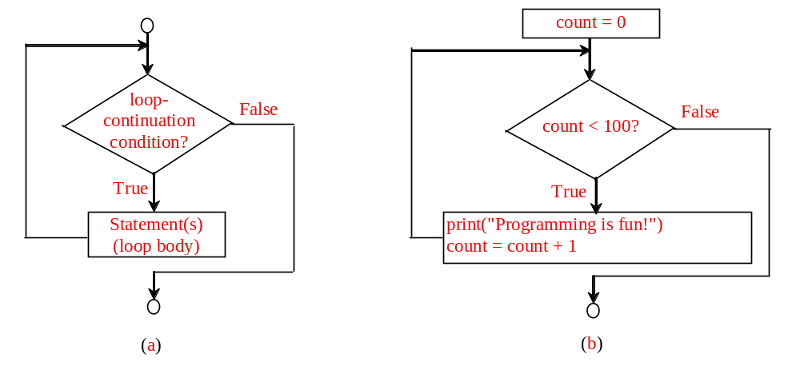
while Loop Flow Chart
count = 0
while count < 100:
print("Programming is fun!")
count = count + 1
while loop-continuation-condition:
# Loop body
Statement(s)

Slide 7
Trace while Loop
animation
Initialize count
count = 0
while count < 2:
print("Programming is fun!")
count = count + 1

Slide 8
Trace while Loop, cont.
animation
(count < 2) is true
count = 0
while count < 2:
print("Programming is fun!")
count = count + 1

Slide 9
Trace while Loop, cont.
animation
Print Welcome to Python
count = 0
while count < 2:
print("Programming is fun!")
count = count + 1

Slide 10
Trace while Loop, cont.
animation
Increase count by 1
count is 1 now
count = 0
while count < 2:
print("Programming is fun!")
count = count + 1

Slide 11
Trace while Loop, cont.
animation
(count < 2) is still true since count is 1
count = 0
while count < 2:
print("Programming is fun!")
count = count + 1

Slide 12
Trace while Loop, cont.
animation
Print Welcome to Python
count = 0
while count < 2:
print("Programming is fun!")
count = count + 1

Slide 13
Trace while Loop, cont.
animation
Increase count by 1
count is 2 now
count = 0
while count < 2:
print("Programming is fun!")
count = count + 1

Slide 14
Trace while Loop, cont.
animation
(count < 2) is false since count is 2 now
count = 0
while count < 2:
print("Programming is fun!")
count = count + 1

Slide 15
Trace while Loop
animation
The loop exits. Execute the next statement after the loop.
count = 0
while count < 2:
print("Programming is fun!")
count = count + 1

Slide 16
The while Loop: a Condition-Controlled Loop
In order for a loop to stop executing, something has to happen inside the loop to make the condition false
Iteration: one execution of the body of a loop
while loop is known as a pretest loop
  Tests condition before performing an iteration
    Will never execute if condition is false to start with
    Requires performing some steps prior to the loop

Slide 17
Infinite Loops
Loops must contain within themselves a way to terminate
  Something inside a while loop must eventually make the condition false
Infinite loop: loop that does not have a way of stopping
  Repeats until program is interrupted
  Occurs when programmer forgets to include stopping code in the loop
# Example 1
i = 1
while i>0:
print(i)
i = i + 1
# Example 2
j = 1
while True:
print(j)
j = j + 1

Slide 18

Problem: An Advanced Math Learning Tool
The Math subtraction learning tool program generates just one question for each run. You can use a loop to generate questions repeatedly. This example gives a program that generates five questions and reports the number of the correct answers after a student answers all five questions.
SubtractionQuizLoop

Slide 19
Problem: Guessing Numbers
Write a program that randomly generates an integer between 0 and 100, inclusive. The program prompts the user to enter a number continuously until the number matches the randomly generated number. For each user input, the program tells the user whether the input is too low or too high, so the user can choose the next input intelligently. Here is a sample run:
GuessNumberOneTime
GuessNumber

Slide 20
Ending a Loop with a Sentinel Value
Often the number of times a loop is executed is not predetermined. You may use an input value to signify the end of the loop. Such a value is known as a sentinel value.
Must be distinctive enough so as not to be mistaken for a regular value in the sequence
Write a program that reads and calculates the sum of an unspecified number of integers. The input 0 signifies the end of the input.
SentinelValue

Slide 21
Numerical Errors
Numeric errors involving floating-point numbers are inevitable.
Floating Point Arithmetic: Issues and Limitations (https://docs.python.org/3/tutorial/floatingpoint.html )
IEEE-754 Floating Point Converter (https://www.h-schmidt.net/FloatConverter/IEEE754.html )
https://realpython.com/python-data-types/#floating-point-numbers
Here is an example that sums a series that starts with 0.01 and ends with 1.0. The numbers in the series will increment by 0.01, as follows: 0.01 + 0.02 + 0.03 and so on.
TestSum

Slide 22
Caution
Don’t use floating-point values for equality checking in a loop control. Since floating-point values are approximations for some values, using them could result in imprecise counter values and inaccurate results. Consider the following code for computing 1 + 0.9 + 0.8 + ... + 0.1:
item = 1
sum = 0
while item != 0: # No guarantee item will be 0
sum += item
item -= 0.1
print(sum)
Variable item starts with 1 and is reduced by 0.1 every time the loop body is executed. The loop should terminate when item becomes 0. However, there is no guarantee that item will be exactly 0, because the floating-point arithmetic is approximated. This loop seems OK on the surface, but it is actually an infinite loop.

Slide 23
The for Loop: a Count-Controlled Loop
Count-Controlled loop: iterates a specific number of times
  Use a for statement to write count-controlled loop
    Designed to work with sequence of data items
      Iterates once for each item in the sequence
    General format:
    for variable in [val1, val2, etc]:
    statements
    Target variable: the variable which is the target of the assignment at the beginning of each iteration

Slide 24
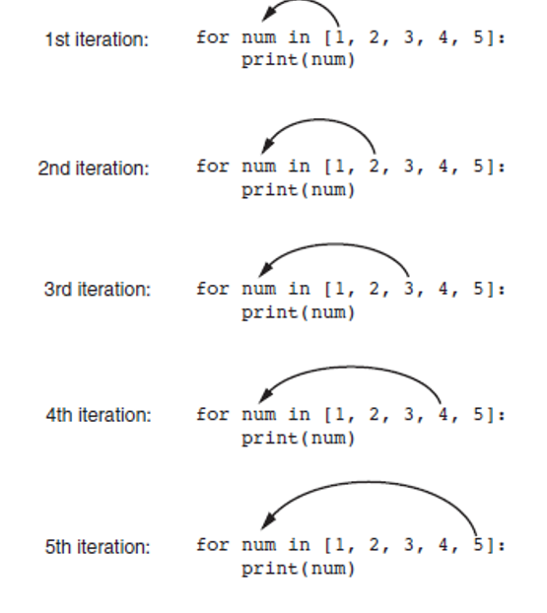
For Loop with a List

Slide 25
Using the range Function with the for Loop
The range function simplifies the process of writing a for loop
  range returns an iterable object
    Iterable: contains a sequence of values that can be iterated over
range characteristics:
  One argument: used as ending limit
  Two arguments: starting value and ending limit
  Three arguments: third argument is step value

Slide 26
One argument: used as ending limit: range(endValue)
>>> for i in range(4):
... print(i)
...
0
1
2
3
>>>
- i starts from 0

Slide 27
Two arguments: starting value and ending limit : range(initialValue, endValue)
for i in range(initialValue, endValue):
# Loop body
i = initialValue # Initialize loop-control variable
while i < endValue:
# Loop body
...
i++ # Adjust loop-control variable

Slide 28
Two arguments: starting value and ending limit : range(initialValue, endValue)
>>> for v in range(4, 8):
... print(v)
...
4
5
6
7
>>>

Slide 29
Three arguments: third argument is step value range(initialValue, endValue, step)
>>> for v in range(3, 9, 2):
... print(v)
...
3
5
7
>>>

Slide 30
Generating an Iterable Sequence that Ranges from Highest to Lowest
The range function can be used to generate a sequence with numbers in descending order
  Make sure starting number is larger than end limit, and step value is negative
  Example: range (5, 1, -1)

Slide 31
Three arguments: third argument is step value range(initialValue, endValue, step)
>>> for v in range(5, 1, -1):
... print(v)
...
5
4
3
2
>>>

Slide 32
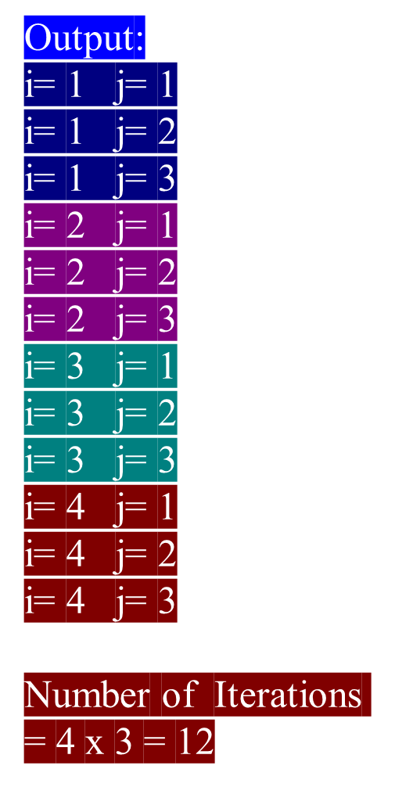
Nested Loops
Nested loop: loop that is contained inside another loop
Inner loop goes through all of its iterations for each iteration of outer loop
Inner loops complete their iterations faster than outer loops
Total number of iterations in nested loop: number_iterations_inner x
number_iterations_outer
for i in range(1,5):
for j in range(1,4):
print("i=",i," j=",j)

Slide 33
Nested Loops
Nested loop: loop that is contained inside another loop
Problem: Write a program that uses nested for loops to print a multiplication table.
MultiplicationTable

Slide 34
Problem:
Finding the Greatest Common Divisor
Problem: Write a program that prompts the user to enter two positive integers and finds their greatest common divisor.
Solution: Suppose you enter two integers 4 and 2, their greatest common divisor is 2. Suppose you enter two integers 16 and 24, their greatest common divisor is 8. So, how do you find the greatest common divisor? Let the two input integers be n1 and n2. You know number 1 is a common divisor, but it may not be the greatest commons divisor. So you can check whether k (for k = 2, 3, 4, and so on) is a common divisor for n1 and n2, until k is greater than n1 or n2.
GreatestCommonDivisor
Run

Slide 35
Problem: Predicting the Future Tuition
Problem: Suppose that the tuition for a university is $10,000 this year and tuition increases 7% every year. In how many years will the tuition be doubled?
FutureTuition
Run

Slide 36
Problem: Predicating the Future Tuition
year = 0 # Year 0
tuition = 10000
year += 1 # Year 1
tuition = tuition * 1.07
year += 1 # Year 2
tuition = tuition * 1.07
year += 1 # Year 3
tuition = tuition * 1.07
FutureTuition
Run

Slide 37

Problem: Monte Carlo Simulation
The Monte Carlo simulation refers to a technique that uses random numbers and probability to solve problems. This method has a wide range of applications in computational mathematics, physics, chemistry, and finance. This section gives an example of using the Monto Carlo simulation for estimating π.
circleArea / squareArea = π / 4.
π can be approximated as 4 * numberOfHits / 1000000.
MonteCarloSimulation
Run

Slide 38
break Statement in Python
The break statement terminates the loop containing it. Control of the program flows to the statement immediately after the body of the loop.
If break statement is inside a nested loop (loop inside another loop), break will terminate the innermost loop.

Slide 39
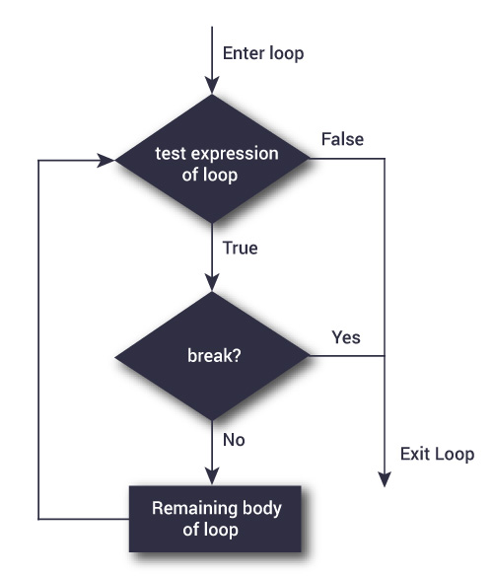
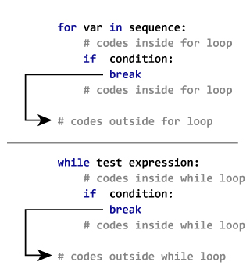
break Statement in Python
# Use of break statement # inside loop
for val in "string":
if val == "i":
break
print(val)
print("The end")
s
t
r
The end

Slide 40
Python continue statement
The continue statement is used to skip the rest of the code inside a loop for the current iteration only.
Loop does not terminate but continues on with the next iteration.

Slide 41
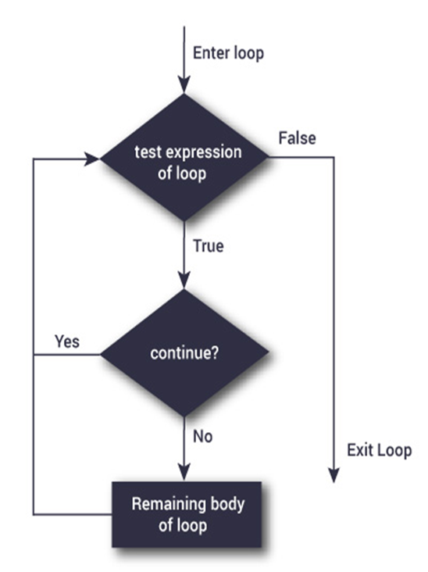
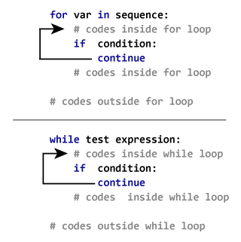
Python continue statement
# Program to show the use of # continue statement inside
# loops
for val in "string":
if val == "i":
continue
print(val)
print("The end")
s
t
r
n
g
The end

Slide 42
Using break and continue
Examples for using the break and continue keywords:
TestBreak.py
TestBreak
TestContinue.py
TestContinue

Slide 43
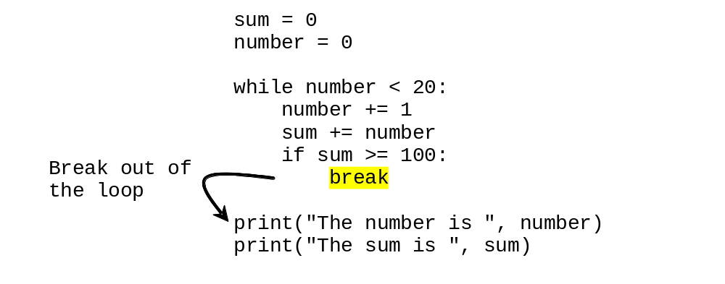
break

Slide 44
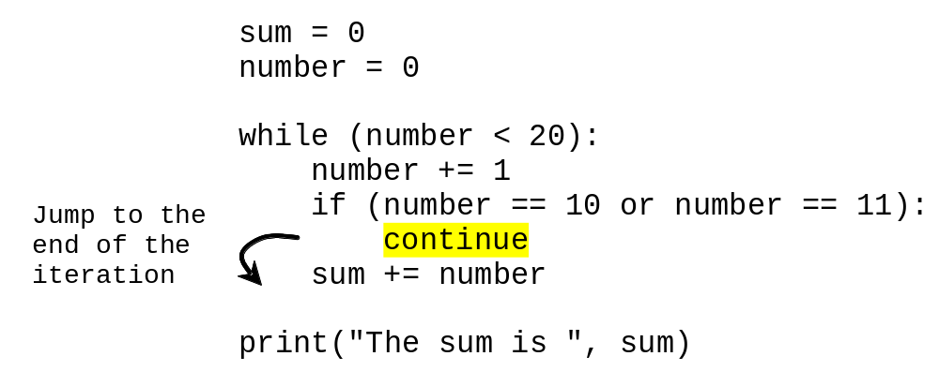
continue

Slide 45
Post-test Loop with break
// C language post-test (do-while) // loop
int i = 1;
do{
printf("%d\n", i);
i = i + 1;
} while(i <= 3);
# Python
i = 1
while True:
print(i)
i = i + 1
if(i > 3):
break
Output:
1
2
3

Slide 46
Guessing Number Problem Revisited
Here is a program for guessing a number. You can rewrite it using a break statement.
GuessNumberUsingBreak

Slide 47
Problem: Displaying Prime Numbers
Problem: Write a program that displays the first 50 prime numbers in five lines, each of which contains 10 numbers. An integer greater than 1 is prime if its only positive divisor is 1 or itself. For example, 2, 3, 5, and 7 are prime numbers, but 4, 6, 8, and 9 are not.
Solution: The problem can be broken into the following tasks:
  For number = 2, 3, 4, 5, 6, ..., test whether the number is prime.
  Determine whether a given number is prime.
  Count the prime numbers.
  Print each prime number, and print 10 numbers per line.
PrimeNumber
Run

Slide 48
Turtle Graphics: Using Loops to Draw Designs
You can use loops with the turtle to draw both simple shapes and elaborate designs. For example, the following for loop iterates four times to draw a square that is 100 pixels wide:
import turtle
for x in range(4):
turtle.forward(100)
turtle.right(90)
turtle.done()

Slide 49
Turtle Graphics: Using Loops to Draw Designs
This for loop iterates eight times to draw the octagon:
import tutle
for x in range(8):
turtle.forward(100)
turtle.right(45)
turtle.done()

Slide 50
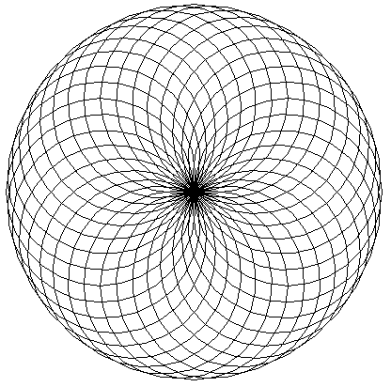
Turtle Graphics: Using Loops to Draw Designs
You can create interesting designs by repeatedly drawing a simple shape, with the turtle tilted at a slightly different angle each time it draws the shape.
import turtle
NUM_CIRCLES = 36 # Number of circles to draw
RADIUS = 100 # Radius of each circle
ANGLE = 10 # Angle to turn
for x in range(NUM_CIRCLES):
turtle.circle(RADIUS)
turtle.left(ANGLE)
turtle.done()

Slide 51
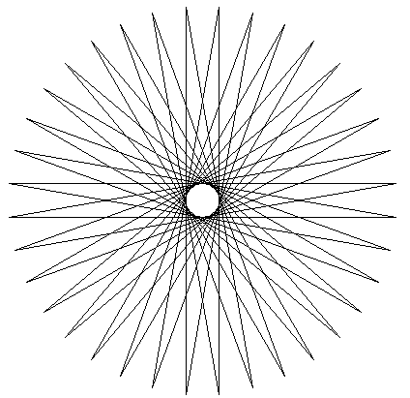
Turtle Graphics: Using Loops to Draw Designs
This code draws a sequence of 36 straight lines to make a "starburst" design.
import turtle
START_X = -200 # Starting X coordinate
START_Y = 0 # Starting Y coordinate
NUM_LINES = 36 # Number of lines to draw
LINE_LENGTH = 400 # Length of each line
ANGLE = 170 # Angle to turn
turtle.hideturtle()
turtle.penup()
turtle.goto(START_X, START_Y)
turtle.pendown()
for x in range(NUM_LINES):
turtle.forward(LINE_LENGTH)
turtle.left(ANGLE)
turtle.done()

Slide 52
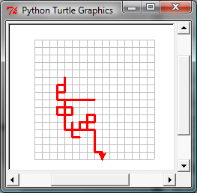
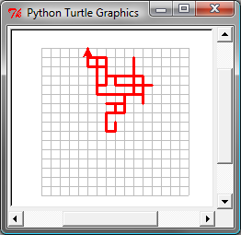
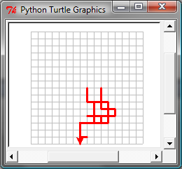
Turtle: Random Walk
RandomWalk
Run

